Slide 1

DevOps Final Project UBER BUS
Team 1:
Sayali Pathare
Shiva Mahitha Maddi

Slide 2
Introduction
Uber Bus Booking application for customer’s Bus Booking Services

Slide 3
Functionalities
· Token based authentication for user Sign in and Sign up
· Web application where user can book a bus and view the bookings history
· User can book bus for multiple Passengers based on bus availability
. Payment using PayPal
.User Registration and Booking confirmation using SMTP Email API
· Ability to select seat from available seats
.Creating secure Password reset with Token via Email

Slide 4
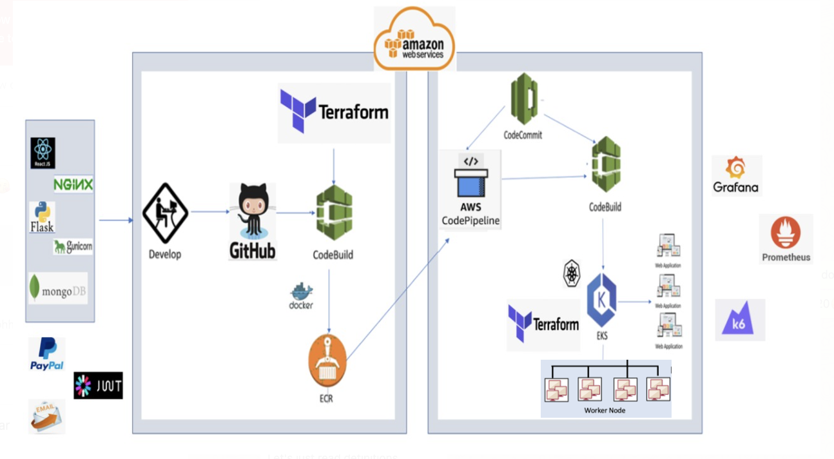
Project Architecture

Slide 5
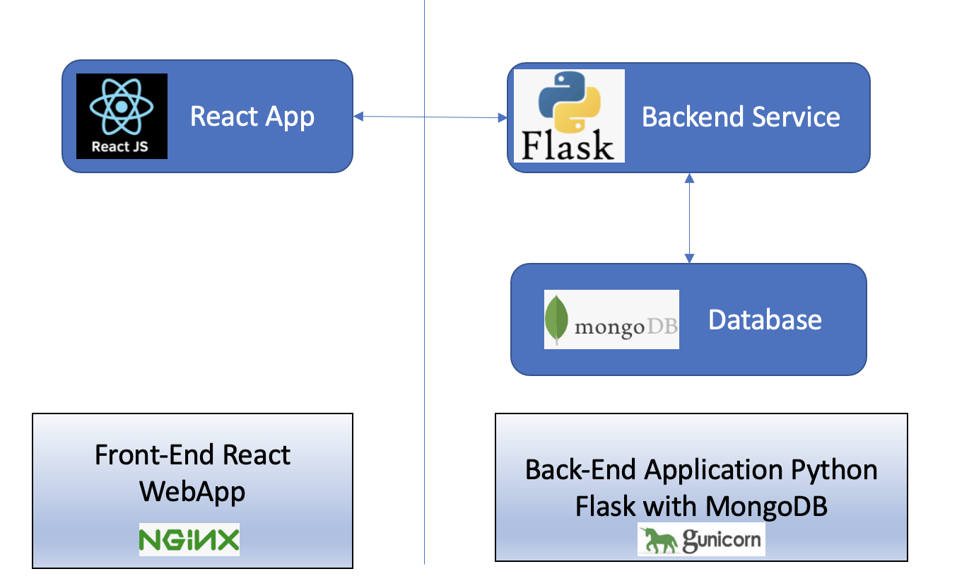
Application Architecture
React Application connected to Backend services
All the requests are routed to Back-End through Load Balancer
Python Flask is integrated with MongoDB to fetch the data for all CRUD operations
User information, Bus Availability, User Booking, Passenger Details, Seat Allocation, Route Selection are stored into the MongoDB for Bus Booking operations

Slide 6
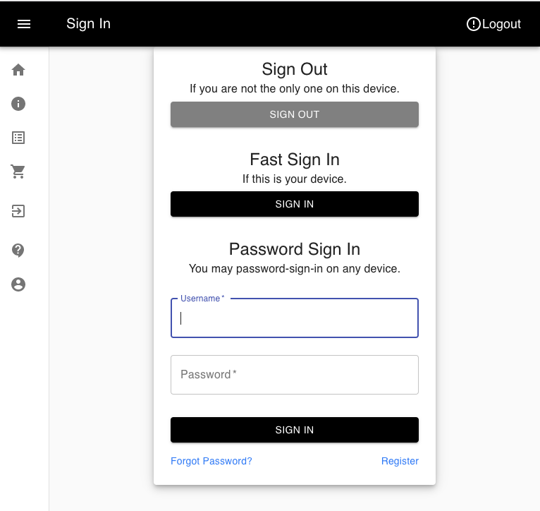
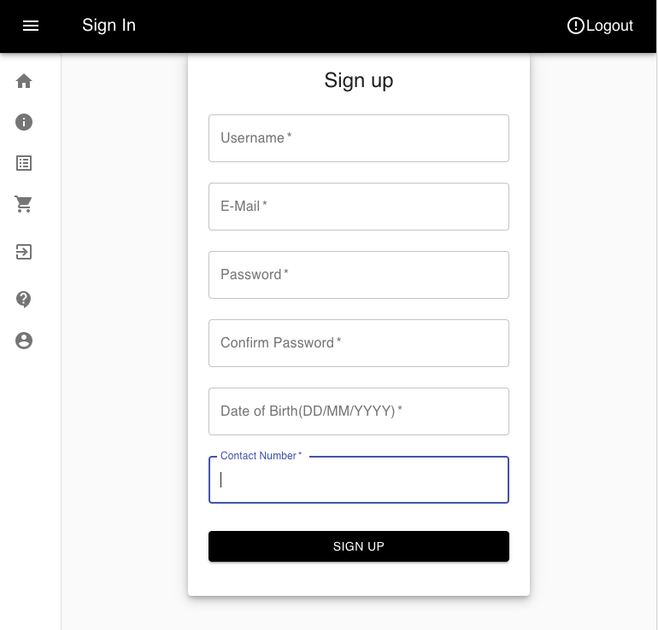
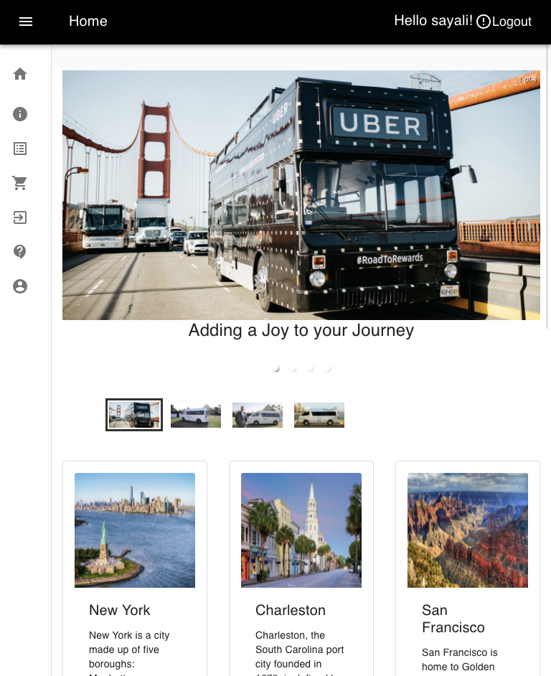


Front End
- The frontend application is created in React JS and deployed on Nginx server
-Login, Sign-up , Forgot password screens for user authentication

Slide 7
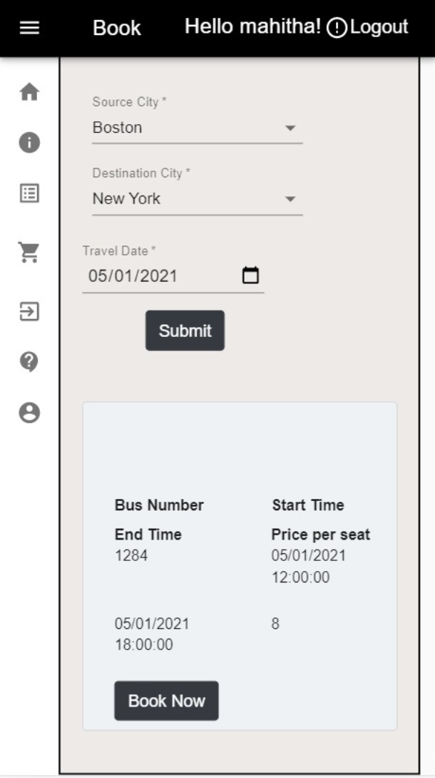
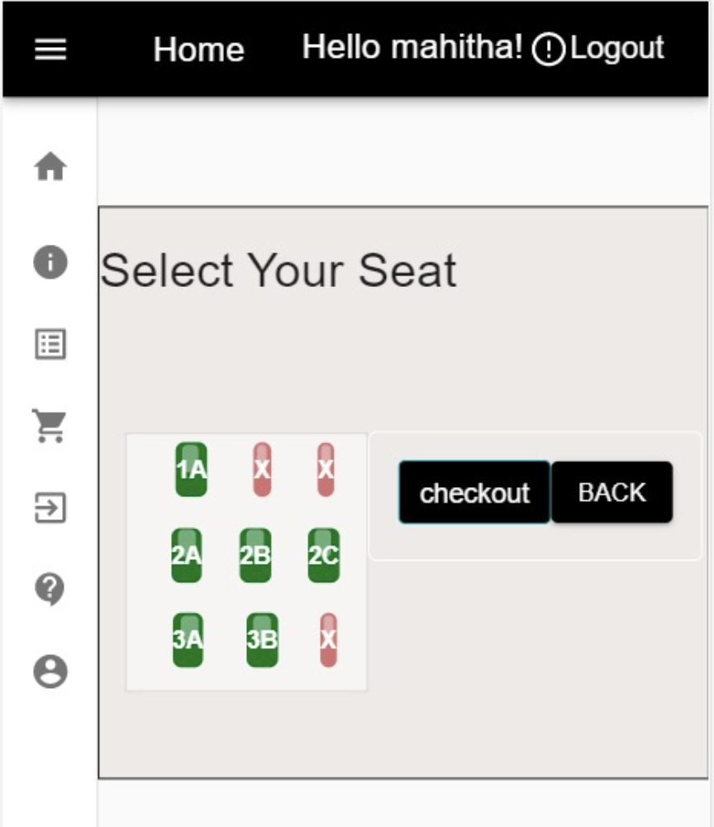
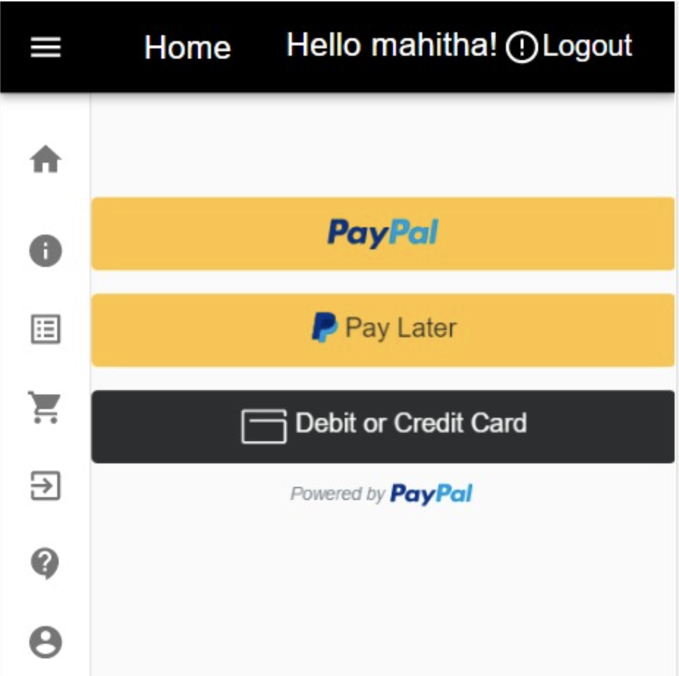
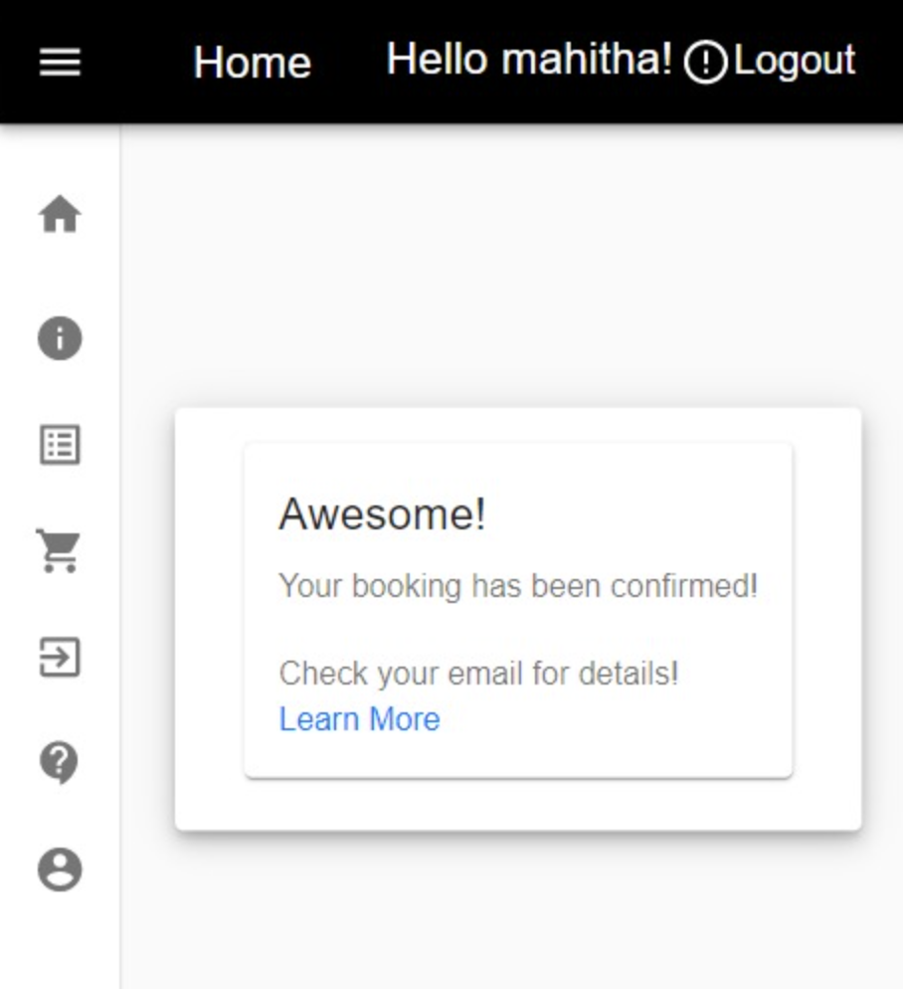
Front End
-Book, Bookings , Seat selection, User Profile, Payment screens for interacting with user
-Home Screen, About Us, Contact Us for Application Information

Slide 8
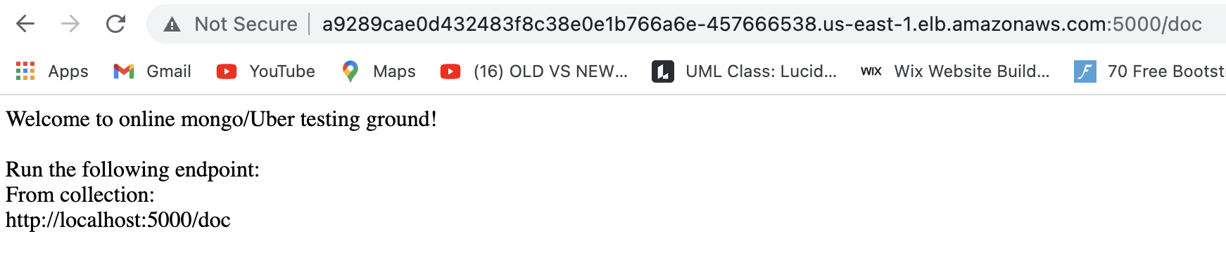


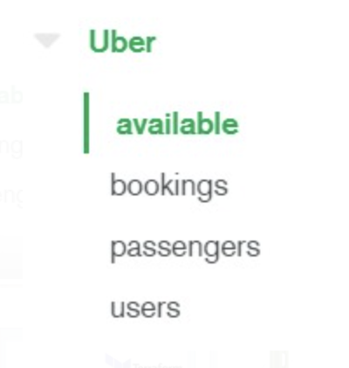

Back End
-All the requests from frontend are routed to Backend Server, for which we have defined below end points to perform all the booking related operations
/overlapCheck
/saveBookedSeats
/saveBooking
/savePassengerDetails
/userEmail
/checkAvailability
/availableseats
/signup
/cancelBooking
/bookings-results
/ForgotPasswod
/checkUserWithEmail
/userDetails
/updateUser
/login
/fastlogin

Slide 9


Infrastructure
-AWS ECR
All the container images are stored, managed, shared and deployed in ECR
-Kubernetes
Infrastructure provisioning using Terraform
AWS - EKS service is used

Slide 10

Infrastructure
-Helm Chart
.Helm is a package Manager for Kubernetes
.Provides a standard, opinionated way to install, configure, upgrade, and run an application in a matter of minutes
-Terraform
.Provisioning of AWS CodeBuild
.Create and Configure AWS EKS Cluster

Slide 11


Infrastructure
-AWS Pipeline
. To automate of release pipeline for fast and reliable application and infrastructure updates
-AWS CodeBuild
. Used it for Continuous Integration
-AWS CodeCommit
.Source Control service to host BuidSpec and Deployment files

Slide 12

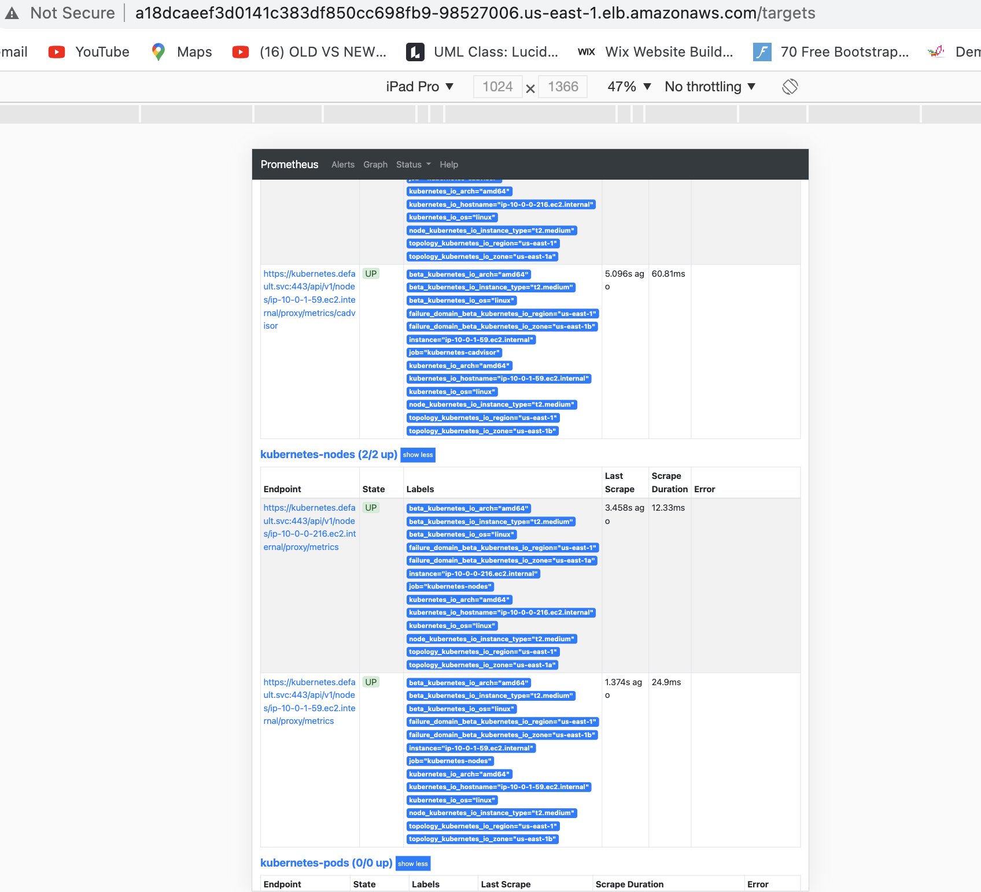
Infrastructure
Prometheus
The Prometheus server is deployed on Kubernetes cluster and analyze and monitor the application traffic on Grafana dashboard

Slide 13
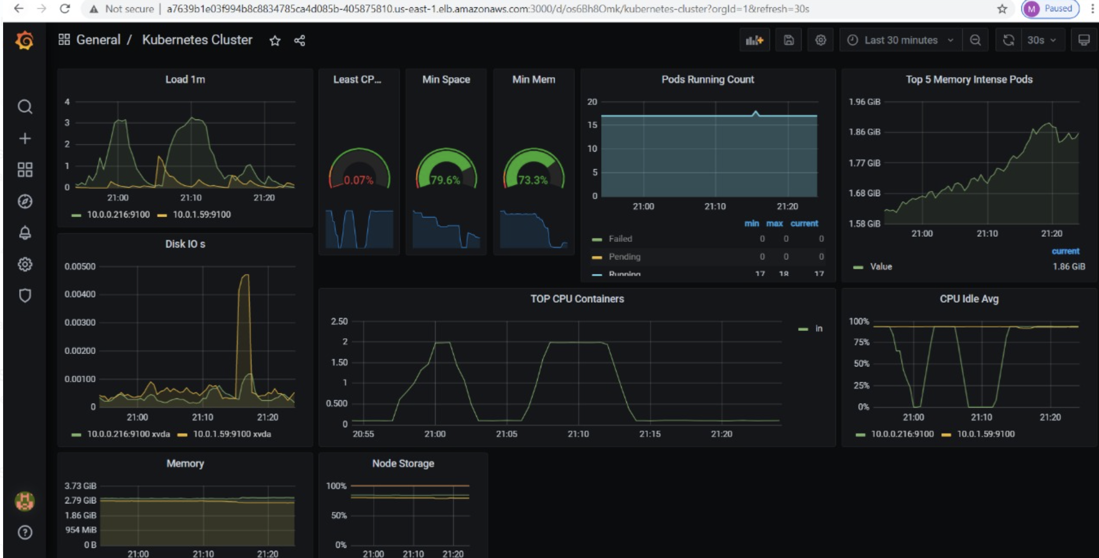


Infrastructure
-AWS ELB
All the incoming requests from the client are load balanced on the AWS using the ELB service of the AWS
-Grafana
Metrics are displayed using Grafana dashboard
HPA is used for pod autoscaling based on CPU load
Custom metrics using service monitor and Prometheus client

Slide 14
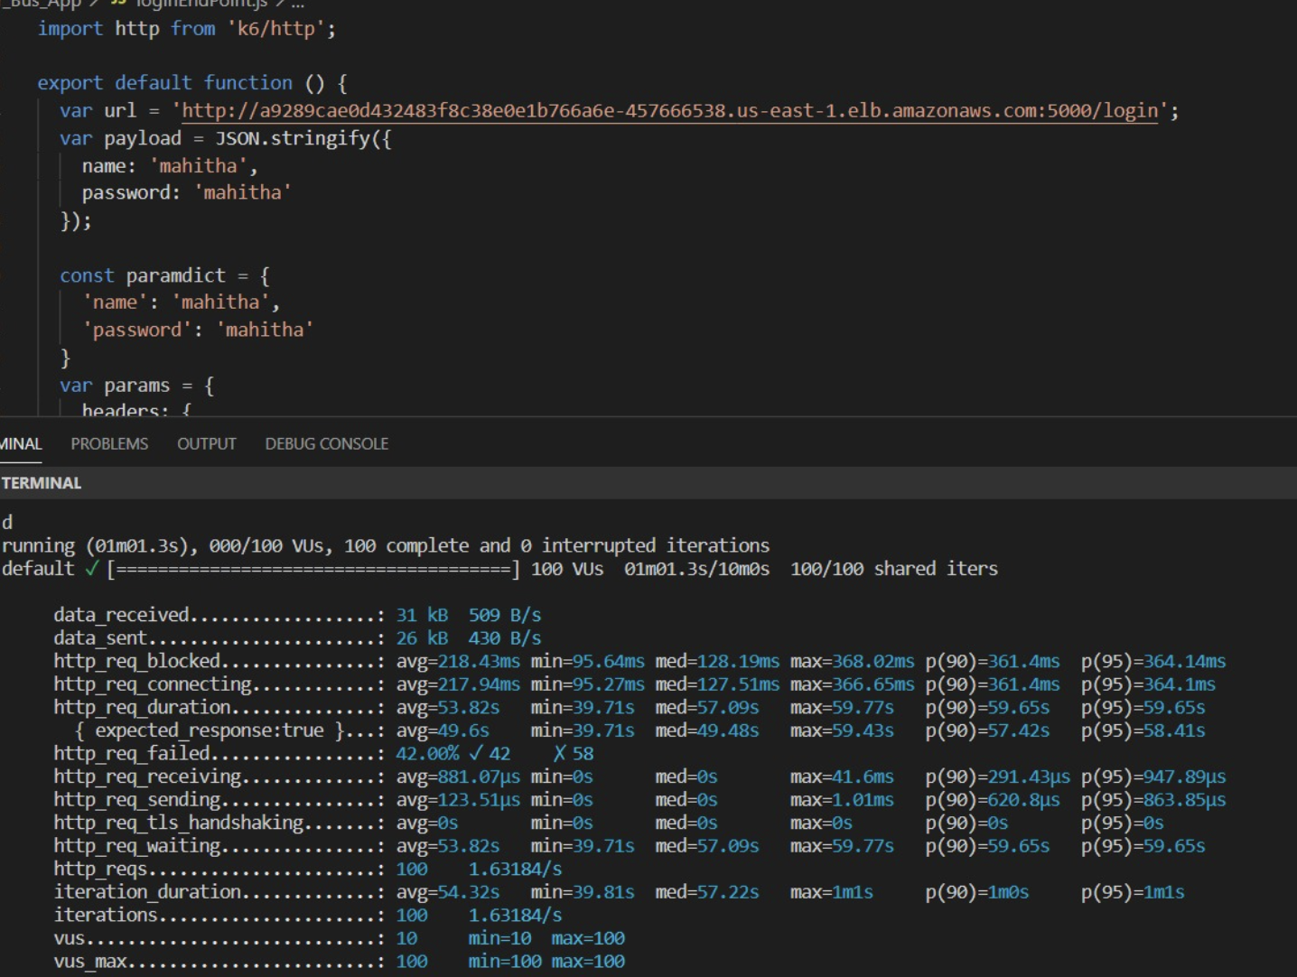

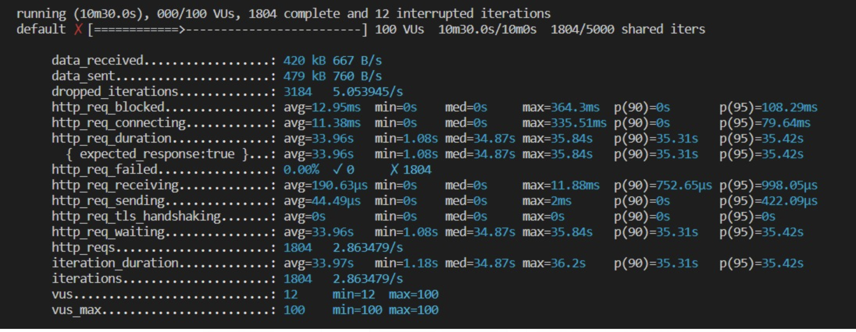

Load Testing K6
1.Load Testing of Login Endpoint with 100 Users – Passed
2. Load Testing of Login Endpoint with 1000 users each with 5 requests (5000 Requests)- Failed

Slide 15

Thank You!

